Slide 1


Towards Facilitating the Removal of Software Defects
Dongliang Mu
Nanjing University && Penn State University
Notes:
大家好，我是慕冬亮，南京大学五年级博士生。目前我在宾州州立大学访问。今天我来讨论一下如何帮助程序员以及安全分析专家更快更好地修复软件缺陷。

Slide 2


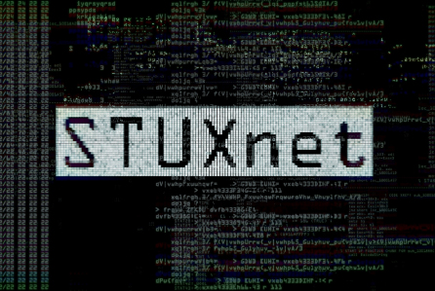

Software Defects Are Prevalent in Real World
CVE-2010-2772
STUXnet
CVE-2014-0160
HeartBleed
CVE-2014-6271
ShellShock
CVE-2017-0144
WannaCry
It is infeasible for in-house teams to identify all possible vulnerabilities before a software release
Notes:
首先，我来介绍一些背景知识。软件漏洞在现实世界中大量存在，且对于用户，企业，甚至国家都是巨大的威胁。我们以2017的WannaCry为例，未修复的漏洞使得WannaCry勒索软件破坏全球超过30万台电脑。图中所示的高危漏洞（震网，心脏出血，破壳）都是在软件发布之后才被发现的。由此可以推断，随着软件复杂度的日益增加，软件公司的内部测试团队已经无法检测到所有可能的漏洞。

Slide 3
How Software Vendors Identify and Fix Vulnerabilities?
Software Vendors Encourage Vulnerability Reporting
Software Vendors Automatically Collect Crash Reports
Notes:
因此，大量的软件公司采取了一些新的措施来确认和修复这些软件漏洞。这些新的措施包括以下两点：一，软件公司鼓励大众，如白帽子，提交漏洞报告。二，软件公司自动化收集软件崩溃报告，并从中发现新的漏洞。

Slide 4








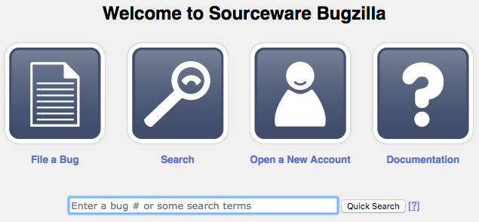


Software Vendors Encourage Vulnerability Reporting
White-hat Hacker
Security Analysts
Vulnerability Reporting
Reproduce
Security Researchers
……
Normal User
The Crowd
Vulnerability Reporting Websites
Developers
Notes:
为了增强白帽子，安全专家，安全研究人员，甚至普通用户提交漏洞报告的积极性，大型软件公司，如谷歌，微软，花费数百万美元来奖励提交漏洞报告的人。为了诊断和修复漏洞，软件公司的开发者在收到提交的漏洞报告之后，首先需要重现这些漏洞。

Slide 5
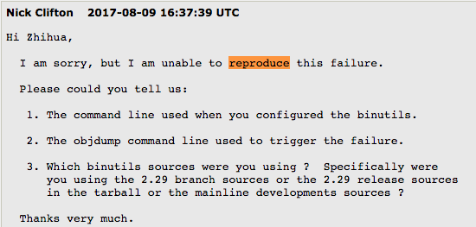
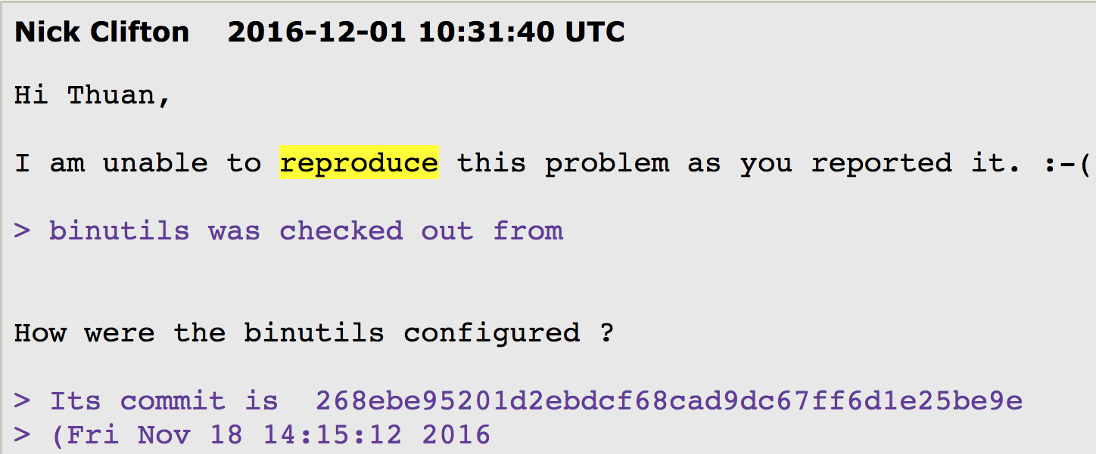
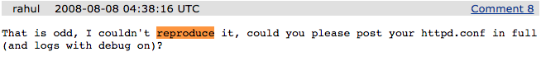
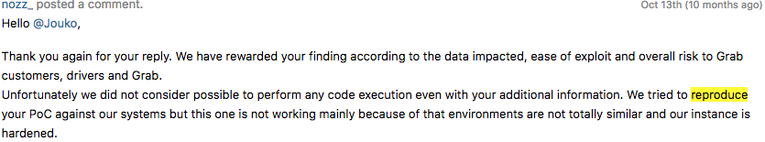
Reproducing Vulnerability Can be Challenging
Notes:
但是有很多证据表明目前的漏洞报告的可重现性很差，如大量的软件开发人员抱怨说，他们无法重现报告中的漏洞。结果会导致这些不可复现的漏洞需要更多的时间和信息去修复。贸然放弃可能会导致非常严重的后果。而截至目前，并没有任何研究工作来调研这些软件报告的可重现性。

Slide 6
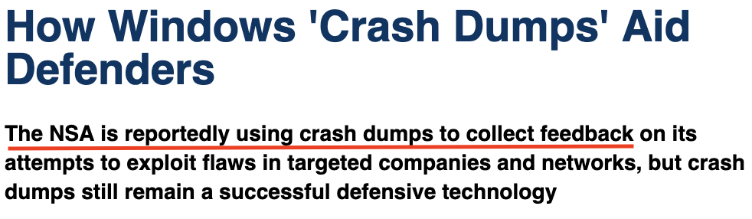
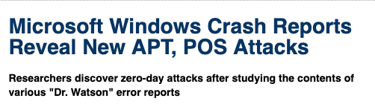
Software Vendors Automatically Collect Crash Reports
Notes:
第二种方案是，软件公司通过自动收集用户提交的崩溃报告来定位和修复漏洞。以下是一些重要软件的崩溃报告提交页面，如微软，谷歌，火狐，Ubuntu等。同时，Websense实验室发布技术报告表明，通过分析Windows系统提交的崩溃报告，他们可以找到新的软件漏洞，APT，以及POS攻击。Websense scoured some 16 Million Microsoft Windows Error Report logs over a 4-month period found five crash reports from four different organizations that appeared to indicate exploit attempts of CVE-2013-3893。由此可见，软件崩溃报告的效果。

Slide 7
It’s Hard to Automatically Analyze Crash Reports
Google, Microsoft , Mozilla and Ubuntu receive millions reports of software crashes every day
There is only a few information attached in the crash reports
The global cost of debugging software has risen to $312 billion annually
Automatic Analysis on Software Crash is urgent
Notes:
虽然软件崩溃报告可以用于检测新的漏洞，但是，微软等软件厂商每天平均收到数以百万级的软件崩溃报告，并且软件崩溃报告中的信息很少。与此同时，全球每年调试软件的价格已经上升至3000多亿，所以，自动化地分析软件崩溃是一件亟待解决的问题。

Slide 8
My Research Focus
Vulnerability Reproduction
Understand the Vulnerability Reproduction (USENIX Security 2018)
Software Crash Analysis
Facilitate software developers to automatically identify software crashes (ACM CCS 2016, USENIX Security 2017, USENIX Security 2019)
Notes:
综上所示，现在世界中的问题主要集中在两个方面 – 漏洞重现和自动化崩溃分析。我主要的研究方向就是集中在这两点。对于漏洞重现，我们通过手动重现300多个漏洞来研究漏洞的可重现性。首先，我们发现漏洞重现需要消耗大量的人力劳动。其次，现实世界中的漏洞报告可重现性比较差。最后，我们建议使用crowdsourcing的方法来提高漏洞的可重现性。

Slide 9
My Research Focus
Vulnerability Reproduction
Understand the Vulnerability Reproduction (USENIX Security 2018)
Software Crash Analysis
Facilitate software developers to automatically identify software crashes (ACM CCS 2016, USENIX Security 2017, USENIX Security 2019)
Notes:
由于报告时间的限制，我后续的报告主要集中于软件崩溃分析。

Slide 10
Roadmap
Background & Motivation
CREDAL: Locate Security Vulnerability with Core Dump (ACM CCS 2016)
POMP: Hardware-assisted Software Crash Analysis (USENIX Security 2017)
DEEPVSA: Facilitate Value-set Analysis with Deep Learning (USENIX Security 2019)
Notes:
在之后的报告中，我首先介绍一些软件崩溃分析的背景知识，然后讨论一下三个我参与的软件崩溃分析的项目 – Credal，POMP，DEEPVSA。这三个工作分别发表在ACM CCS 2016，Usenix Security 2017 和 2019.

Slide 11
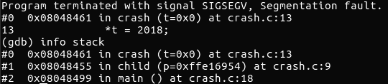
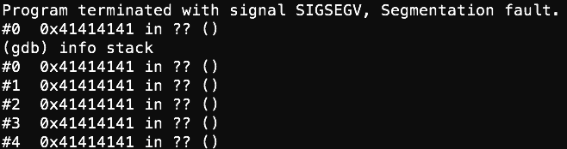
Software Crash Analysis is Challenging
In general, a coredump carries information, such as
Memory snapshot
Registers
Others (e.g., signals received)
Memory corruption vulnerability damages information in the core dump
Corrupted Crash Site
Corrupted Stack Trace
Unreliable Memory Data
Notes:
从技术角度来讲，软件崩溃分析十分具有挑战性。因为当软件崩溃或者非正常退出时，我们只有很少量的信息。普遍说来，我们只有一个操作系统生成的coredump文件，该文件中包含程序崩溃时刻的内存快照以及寄存器等信息。而我们主要的研究对象是内存破坏漏洞，该类型漏洞的危险系数很高。并且，内存破坏漏洞会破坏coredump中存留的数据，导致出现错误的崩溃点，栈帧以及不可靠的内存数据。从右图中我们可以看出，程序的崩溃点和栈帧已经被破坏了。

Slide 12
Roadmap
Background & Motivation
CREDAL: Locate Security Vulnerability with Core Dump (ACM CCS 2016)
POMP: Hardware-assisted Software Crash Analysis (USENIX Security 2017)
DEEPVSA: Facilitate Value-set Analysis with Deep Learning (USENIX Security 2019)
Notes:
针对这个问题，我们开发了Credal，并简要说明它是如何根据coredump的信息来定位安全漏洞的根本原因。

Slide 13
CREDAL: Locate Security Vulnerability with Core Dump
Core Dump
CREDAL
Vulnerability Existence
Corrupted Data Objects
Vulnerable Code Segments
Source Code
Executable
CREDAL is particularly designed for Memory Corruption Vulnerability
Meanwhile, its main challenge is from Memory corruption Vulnerability
Notes:
Credal以软件源码，可执行文件，软件崩溃时生成的coredump作为输入。通过内部分析，Credal尝试输出三种有效信息。首先是，确认是否存在软件漏洞；其次是报告被破坏的数据对象；最后是有漏洞的代码区域。Credal是专为 Memory corruption vulnerability导致的软件崩溃设计的。而Credal中遇到的Challenge来自于内存破坏漏洞。

Slide 14
Core Idea
Reconstruct Execution Path
Analyze Data Flow
Locate Vulnerability
S
S
1
1
2
2
1
3
X
3
Core Dump
3
Core Dump
x
Core Dump
X
E
Execution Flow
Code Executed Before Crash
Data Flow
(1)
(2)
(3)
Notes:
首先，我们利用coredump中的信息来恢复程序的执行流。由于内存破坏漏洞的干预，程序崩溃点以及执行流可能会被破坏。在这种情况下，我们利用程序栈上残留的未被破坏的数据进行forensic分析，从而定位到正确的软件崩溃点和程序执行路径。其次，根据程序的执行路径，重构数据流。基于恢复的程序执行路径和coredump中的数据，我们利用可达和指向分析来发现数据的不一致性，从而定位到被破坏的数据对象。最终，从程序崩溃点开始，定位出导致程序崩溃的缺陷代码。

Slide 15
Limitation of Credal
CREDAL requires the availability of source code
Attackers may actively prevent the diagnosis of CREDAL
Notes:
虽然Credal可以成功恢复出大多数软件崩溃的执行流，且定位出被破坏的数据对象以及漏洞位置，但是Credal受到两方面的限制：1. Credal需要源码的支持；2. 攻击者可能利用Credal诊断漏洞的思路来对抗这种分析方法。

Slide 16
Roadmap
Background & Motivation
CREDAL: Locate Security Vulnerability with Core Dump (ACM CCS 2016)
POMP: Hardware-assisted Software Crash Analysis (USENIX Security 2017)
DEEPVSA: Facilitate Value-set Analysis with Deep Learning (USENIX Security 2019)
Notes:
为了弥补之前Credal限制，我们进而提出POMP，即，硬件辅助的基于二进制的软件崩溃分析

Slide 17
Hardware-enhanced Core dump
Core dump is enhanced by Intel Processor Tracing which enables execution tracing with nearly no overhead
A hardware-enhanced core dump unveils not only a crashing state but more importantly captures the control flow a crashing program follows
Memory
Registers
Trace
Signal etc.
Core dump
A1: push ebp
A2: mov ebp, esp
A3: sub esp, 0x14
A4: mov [ebp-0xc], test
……
A18: add esp, 0x4
A19: mov eax, [ebp-0xc]
A20: call eax ;crash site
Notes:
鉴于coredump中记录的信息比较有限，我们利用Intel PT这种硬件特性，可以基本零开销地记录目标程序的执行流，并且还可以将记录的执行流集成到coredump中。因此，这种新型的coredump中既包含程序崩溃时刻的状态，更重要的是记录了程序崩溃的控制流。对于这种新型的coredump，我们如何用它来辅助程序员来分析软件崩溃呢？

Slide 18
POMP: Hardware-assisted Software Crash Analysis
Reverse Execution
Reversely execute the crashing trace starting from the crash site
Reconstruct the data flow that a program followed prior to its crash
Backward Taint Analysis
Figure out why a bad value was passed to the crash site
A1: push ebp
A2: mov ebp, esp
A3: sub esp, 0x14
A4: mov [ebp-0xc], test
……
A18: add esp, 0x4
A19: mov eax, [ebp-0xc]
A20: call eax ;crash site
Data Flow Graph
Notes:
为了解决上述问题，我们提出了POMP。执行路径已经被Intel PT记录并集成至coredump中，所以POMP主要需要恢复数据流和定位漏洞根本原因。我们采用的是逆向执行来恢复程序数据流。从崩溃点开始，我们逆向执行每一条语句，并以此重构程序的数据流； 二是，利用后向染色分析定位漏洞root cause。根据之前重构的程序数据流，以导致程序崩溃的数据对象为染色源，通过后面染色来找到所有可能对程序崩溃有贡献的指令。

Slide 19
Challenge - Memory Alias Problem
Invertible instructions (like add, sub) makes it possible to reverse back
Non-invertible instructions (like xor, mov) lead to unknown memory write
A1: mov ebx, edx
A2: mov ecx, [edi]
A3: mov [ecx], esi
A4: mov ecx, 0x77
A5: mov ebx, [eax]
[edi] in A2
Memory Cell
[ecx] in A3
ecx = ?
Core Dump
Notes:
在程序逆向执行过程中，我们会遇到一些不可逆向的指令，如xor，mov。这些指令会导致运行前的数据状态被清除。以图中A4指令为例，这条mov不可逆，它会使得ecx在A4执行之前的状态变成未知。因此，A3指令中会出现未知地址的内存写操作。为了求出对应的内存地址，我们通过前向分析找到A2，只要我们知道了[edi]的值，ecx就可解。然而，我们不知道[ecx]是否会影响[edi]。因此，现在的问题就变成了[edi]和[ecx]是否alias或者说指向同一块内存区域的问题。

Slide 20


Hypothesis Testing
Making two hypotheses for each pair of memory
Constructing use-define chain and extracting constraints under each hypothesis
Testing each of the hypotheses by using the constraints in each set
A1: mov ebx, edx
A2: mov ecx, [edi]
A3: mov [ecx], esi
A4: mov ecx, 0x77
A5: mov ebx, [eax]
Constraint Set 1
Alias
[edi] in A2
Instruction Semantics
Use-define Chain
[ecx] in A3
Constraint Set 2
Non-Alias
Notes:
为了解决内存别名，我们提出hypothesis testing，即，对内存访问的别名关系进行两种假设，分别是alias 和 non-alias。不同的假设会给程序状态带来不同的限制（constraint）。当我们发现程序执行过程中出现了冲突（conflict），也就是说constraint无法得到满足，我们就会reject当前的hypothesis。

Slide 21
Limitation of POMP
The complexity of Hypothesis Testing is exponential
As the probability of two memory accesses being aliased is not uniformly random, Hypothesis Testing will waste lots of time in memory alias verification.
Alias
Memory Pair
Memory Pair
……
Alias
Non-Alias
Memory Pair
Memory Pair
Alias
Memory Pair
Non-Alias
Memory Pair
……
Non-Alias
Memory Pair
Notes:
虽然POMP可以成功地定位大多数漏洞的根本原因，但是执行时间和别名分析都受到Hypothesis Testing的限制。如上图所示，在进行假设之后没有遇见conflict反而见到了新的alias pair，继续假设以期望找到conflict，Hypothesis Testing的复杂度是指数级的。然而，两个内存访问之间的别名关系并不是随机的，而是有迹可循的。Hypothesis Testing会白白消耗大量的时间去假设和验证。

Slide 22
Roadmap
Background & Motivation
CREDAL: Locate Security Vulnerability with Core Dump (ACM CCS 2016)
POMP: Hardware-assisted Software Crash Analysis (USENIX Security 2017)
DEEPVSA: Facilitate Value-set Analysis with Deep Learning (USENIX Security 2019)
Notes:
鉴于Hypothesis Testing的效率过低，我们引入新的技术来解决软件崩溃分析的内存别名问题（Memory Alias Analysis）

Slide 23

How to Improve Memory Alias Verification?
Intuition: static analysis could help the understanding of memory alias
State-of-art : Value Set Analysis (VSA)
Being integrated into a variety of binary analysis frameworks (Angr, BAP)
Value Set Representation:
((Region1, Offset), (Region2, Offset), …, (RegionN, Offset))
Split Address Space into several disjoint memory areas
Notes:
直觉告诉我们，静态分析可以帮助我们理解内存别名问题。目前最先进的静态分析技术是Value-set Analysis，简称为VSA。VSA 将程序的进程地址空间分为几个不相交的区域，如Global，Heap，Stack，并利用Region+Offset的形式里表示数据对象的值或地址。由于数据对象的值或者地址在静态时并不能唯一确定，所以一个数据对象需要由一个多元组的Region+Offset来表示，也是所谓的value set。而VSA解决内存别名的方法就是比较两个内存访问地址的Value set。如果两者的value set没有交集，那么说明，两者不alias；反之，两者可能alias。

Slide 24
VSA is Unsuitable in Software Crash Analysis
Memory region that an instruction accesses can be determined by :
Semantics of that instruction
push eax: indicate a stack access
Context indicated by previous instructions
In the context of Software Crash Analysis :
The full control flow or execution trace is not available.
Core dump can only record limit length of execution trace.
VSA will perform over-approximation in value-set construction.
A1: 8D 1C 24 lea ebx, [esp]
A2: 89 0B mov DWORD PTR [ebx], ecx
Notes:
VSA确认指令所访问内存区域的方法有以下两种，一个是根据指令的语义， push指令表明指令访问的是栈空间。第二是根据前面指令提供的上下文。如右图所示，lea指令将esp内存访问的地址赋值给ebx，因此A2指令中，[ebx]所访问的内存区域是栈空间。然而，在软件崩溃分析的上下文中，由于各种限制性因素，我们只能记录下来程序崩溃之前的部分连续指令。这会导致VSA对数据对象的Value-set产生过估。

Slide 25
How to Improve Value-set Analysis?
Memory alias analysis can be simplified as the relationship between instruction sequence and corresponding value-set of memory access, meanwhile, deep learning is good at finding such relationship
Previous applications demonstrated that DL can be used to learn patterns from input and assign each input an label
nop; nop; nop; nop; sub esp, 0x4c;
90 90 90 90 83 EC 4C
Binary Function Start Identification (Usenix Security’15)
Recurrent Neural Network (RNN)
0 0 0 0 1 0 0
Notes:
那么我们如何来提高VSA的准确性呢？正如之前提到的，VSA总结了确定指令所访问区域的pattern。对于Memory Alias Analysis，我们可以将其抽象并简化成为分析指令序列和其内存访问的value set之间的关系。同时，Deep learning的记忆归纳总结能力很强，可以从binary中识别出来这些pattern。而之前的工作，如确定二进制函数起始，已经向我们证明了这一点。

Slide 26
DEEPVSA: Facilitate Value-set Analysis with Deep Learning
Instruction trace
Crashing Trace
Predicted Memory Region
Deep Learning Model
Deep Learning Model
Label (memory region)
Predicted Memory Region
Value-set Analysis
1. Train Deep Learning Mode with Training Data Set
2. Predict Memory Region with trained Deep Learning Model
3. Integrate and facilitate VSA with predicted Memory Region
Notes:
因此，我们提出deepvsa，即使用deep learning来辅助VSA。首先，我们根据收集的指令集合与对应的内存区域，也就是ground truth来训练一个Deep Learning模型。这个模型，是根据二进制分析的特点进行定制。其次，使用我们训练的Deep Learning模型来预测crashing trace中指令访问的内存区域。最后我们将预测的内存区域集成到VSA中，从而辅助VSA更精确地判断内存别名关系以及获得更好的软件崩溃分析结果。

Slide 27
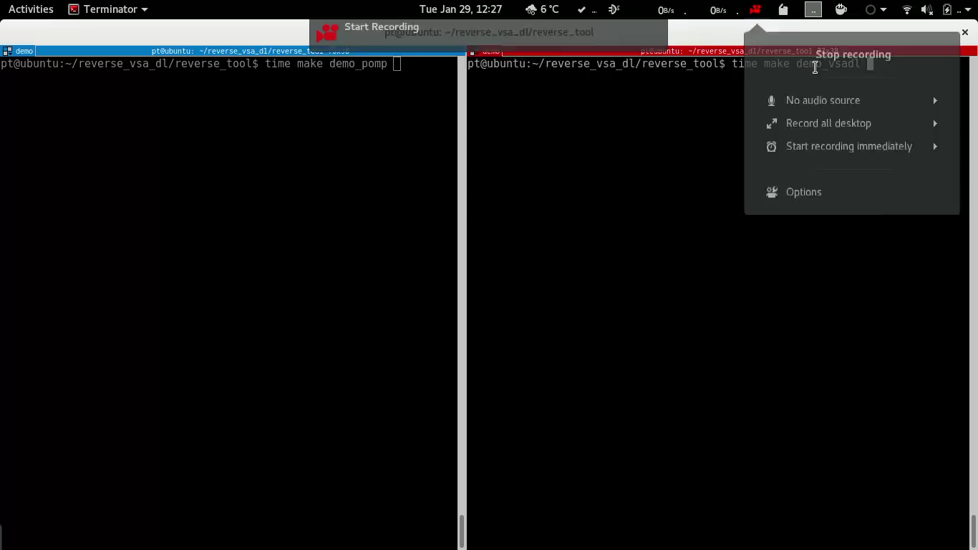
Facilitate Software Crash Analysis With VSA && DL
Notes:
下面请看我们利用vsa&deeplearning 来辅助软件崩溃分析的demo。Demo中软件崩溃分析主要分为三个阶段：指令解析，逆向执行，后向染色分析。
通过VSA 以及 Deep Learning的辅助，我们可以极大地提高软件崩溃分析的效率，同时，这种辅助还可以增加软件崩溃分析的准确性。

Slide 28
Conclusion
The fix of software vulnerability needs reproducing the vulnerability or analyzing crash reports
Vulnerability reproduction and software crash analysis are difficult and needs extensive manual effort
Software crash analysis and Vulnerability reproduction could facilitate developers efficiently and accurately locate the root cause of software defects
Notes:
最后我们总结这个报告，并给出以下结论：软件漏洞的修复需要重现该漏洞或者分析对应的崩溃报告；漏洞重现和软件崩溃分析非常困难且需要大量的人力劳动；软件崩溃分析和漏洞重现可以帮助软件开发者更有效地，更精确地定位软件缺陷的根本原因。

Slide 29
Q&A
Name: Dongliang Mu
Homepage: https://mudongliang.github.io/about/
Email: dzm77@ist.psu.edu
Notes:
最后，感谢大家来参加我的报告。

Slide 30
Our Findings of Vulnerability Reproduction
Finding 1 : Vulnerability is difficult to reproduce
Finding 2 : Key Factors makes reproduction difficult (Top 3)
Trigger Method
Software Installation
PoC (Proof-of-Concept)
Software Configuration
Finding 3 : Useful Tips for Information Recovery
Priority of Information
Correlation of Different Vulnerabilities
Tools which infer Missing Information from Crash Dump

Slide 31
Crash Reports Reveal Software Defects
Websense scoured some 16 Million Microsoft Windows Error Report logs over a 4-month period
found five crash reports from four different organizations that appeared to indicate exploit attempts of CVE-2013-3893
spotted traffic going to a remote access Trojan typically associated with targeted attacks called Houdini H-Worm
Notes:
如果快速有效地分析软件崩溃报告，并从中找出造成软件崩溃的漏洞是一个亟待解决的问题。
In an industry first, Websense® Security Labs™ researchers used Windows Error Reporting (WER) crash reports to detect zero-day exploits in the wild.

Slide 32
Combine Reverse Execution and Value-set Analysis
Effectiveness
Facilitate Memory Alias Verification
A1: push ebp
A2: mov ebp, esp
A3: sub esp, 0x14
A4: mov [ebp-0xc], test
……
A18: add esp, 0x4
A19: mov eax, [ebp-0xc]
A20: call eax ;crash site
Value Set Analysis
Reverse Execution
Efficiency
Help infer more value sets

Slide 33
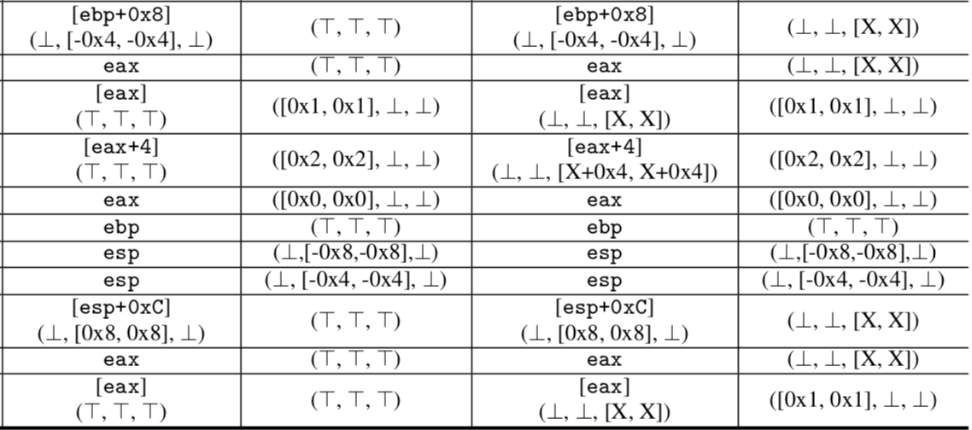
VSA is Unsuitable in Postmortem Program Analysis
In the content of postmortem program analysis:
The full control flow or execution trace is not available
VSA relies on control flow and context to infer memory address of a-loc
may point to anywhere

Slide 34
Exponential Hypothesis Testing
The complexity of Hypothesis Testing is exponential
As the probability of two memory accesses being aliased is not uniformly random, Hypothesis Testing will waste lots of time in memory alias verification.
If we directly assume every memory alias pair is non-alias, what will happen?
M1
M2
M3
Mn
Non-Alias
Non-Alias
……
M1’
M2’
M3’
Mn’
Notes:
REPT: only explore one path, but will revert when encountering conflict; however, it may left error value in the result(fidelity).

